Slide 1
Delivery Planning for the LPG Distributor - SAO Gas Ltd
ALGORITHM DESIGN AND COMPARISON FOR AN OPTIMIZATION PROBLEM
By Divya Das

Slide 2
PROBLEM CONTEXTUALIZATION
Company – SAO Gas Ltd – distribute LPG to Optilandia
No of Depots - 5
No of Vehicles- 25 (5 each depot- small, medium and large)
Data Sets Provided
1. SaO_Optilandia_locations.csv
Location IDs, x and y coordinates , capacity , level.
2. SaO_Optilandia_links.csv
3. SaO_Optilandia_depot_lorries.json
Lorry details i.e lorry IDs, capacity, cpm, cptm
Speed – 50 miles/hour

Slide 3
PROBLEM CONTEXTUALIZATION
Problem 1: Minimize Time,
only contraint is vehicle capacity
Problem 2: Maximize Cost-Efficiency
Which is to maximize gas delivered and minimize cost of delivery
Constraints
1. Stop 20 min after every 2 hours of continuous drive
2. Customer stop limits. Small vehicle-4, Medium – 8 & Large - 16
3. Can end and refill at any depot
4. If any customer less than 50% at end 1000 pounds fine

Slide 4
APPROACH
Cluster- Route- Cluster
1. Divide or cluster customer into 5 each for a depot
2. Apply Optimization Algorithm and get an optimized path
3. Then divide the path for vehicles depending on constraints
OPTIMIZATION SCHEMES
1. Genetic Algorithm
2. Greedy Scheduler

Slide 5
METHODOLOGY
For both problem, convert dataset into dataframes using Pandas Library
Divide the customers into 5 groups
Multi Source Dijkstras Shortest Path Algorithm
- Nearest Depot
Used NetworkX Library to visualize the Optilandia network graph

Slide 6
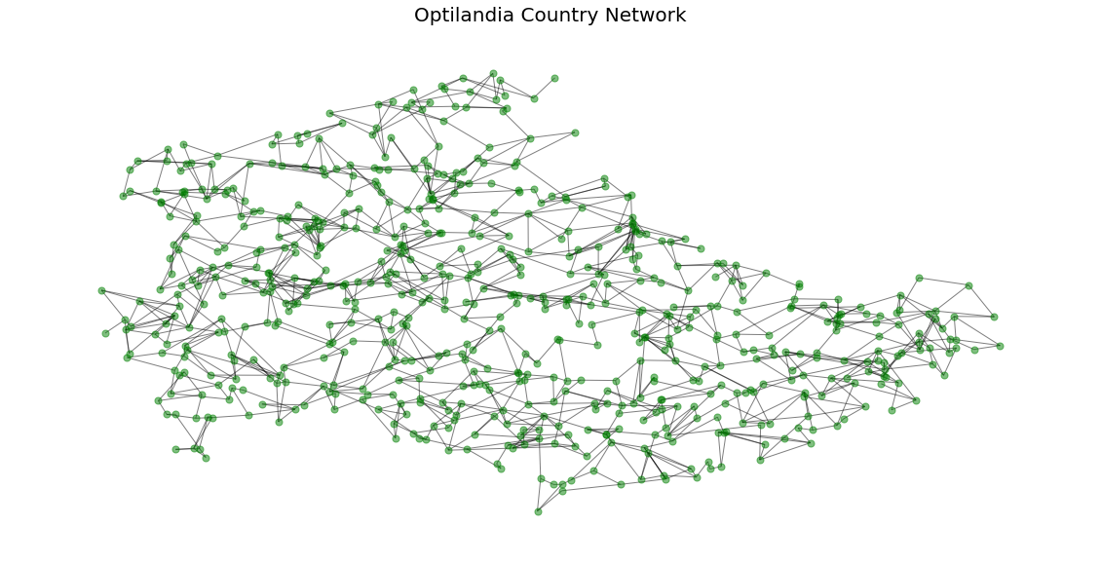
COUNTRY OF OPTILANDIA NETWORK

Slide 7
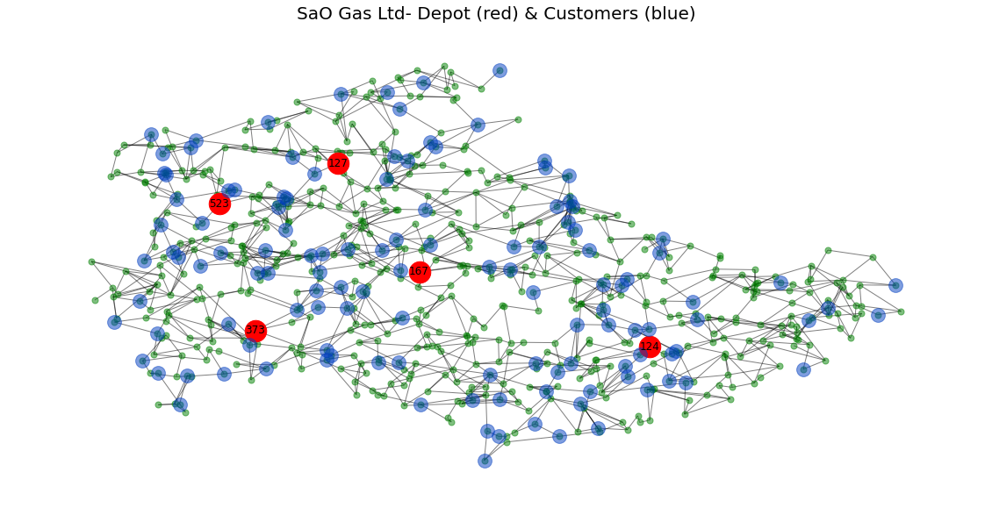
Red- Depot, Blue- Customers, Green - Nodes

Slide 8
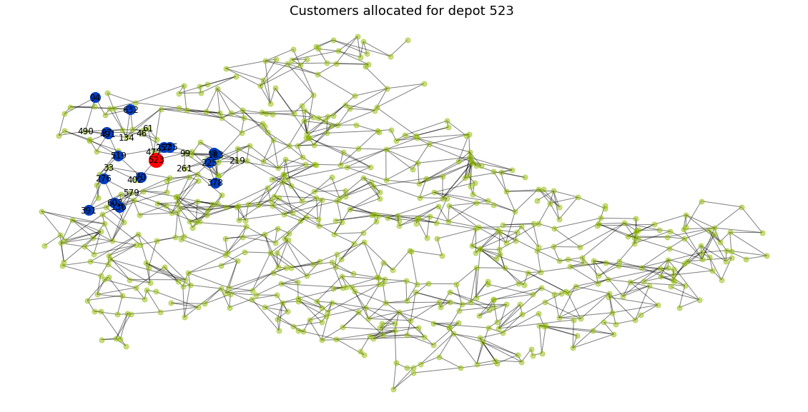
Network with highlighting customers of one depot

Slide 9
PROBLEM 1
Minimize Time, vehicle capacity is only constraint
Time =(distance [miles] / speed [miles/hour]) * 60 + Weight [tonnes] * 10 [min/tonne] + 5 [min]
Time α Distance
Minimize distance to minimize time in Fitness Function
Genetic Algorithm
Initialization
Fitness Evaluation
Selection – Tournament Selection
CrossOver – Single point crossover with correction
Mutation – Inversion Mutation

Slide 10
PROBLEM 2
Minimize Cost Efficiency
Cost Efficiency = Total Gas delivered to all customer / cost of delivery
Cost = distance * (cpm + weight [tonnes] * cptm)
Cost α Distance
Maximize gas delivered and minimize cost
Greedy scheduler or Algorithm used to get optimized path
Use Nearest node approach using all pair Dijkstras shortest path algorithm

Slide 11
PROBLEM 2 Constraints
1. Stop 20 min after every 2 hours of continuous drive
To achieve this 2 hours is 100 miles so whenever distance between two customers is more than 100 break is added
2. Stop limits: Small vehicle-4, Medium – 8 & Large – 16
To achieve if vehicle exceeds this stop limit in trip the trip is ended and back to depot
3. Can end and refill at any depot
For refilling nearest depot is found and used for refilling
4. If any customer less than 50% at end 1000 pounds fine
50% below fuel – must customer and penalty is added if unvisited

Slide 12
CONCLUSION
Both Genetic and greedy algorithm generates optimal paths
The Genetic algorithm is based on randomness it takes more time and generate less optimal solution.
The Greedy algorithm which uses the greedy mechanism to find the next nearest node rather than random so generate the more optimal path in less time compared to genetic algorithm.

